Slide 1
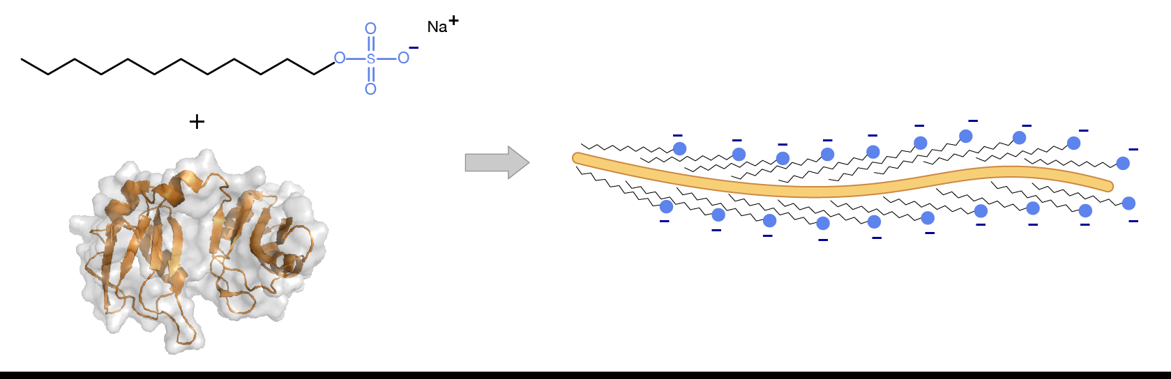


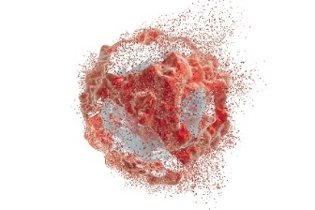


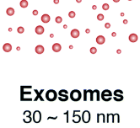
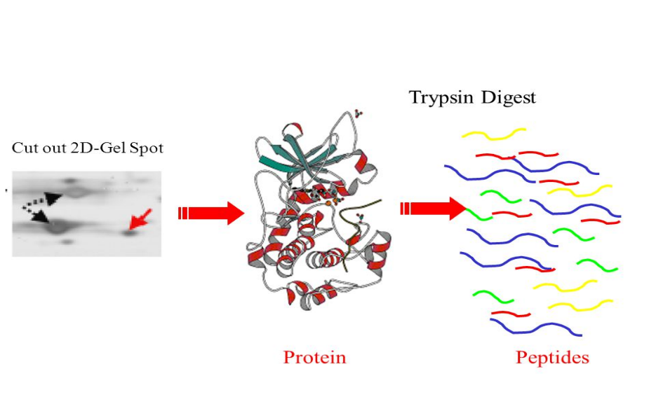
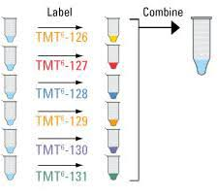
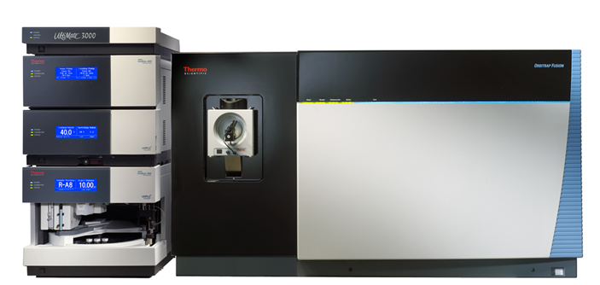

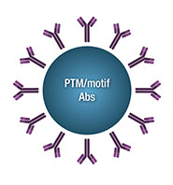
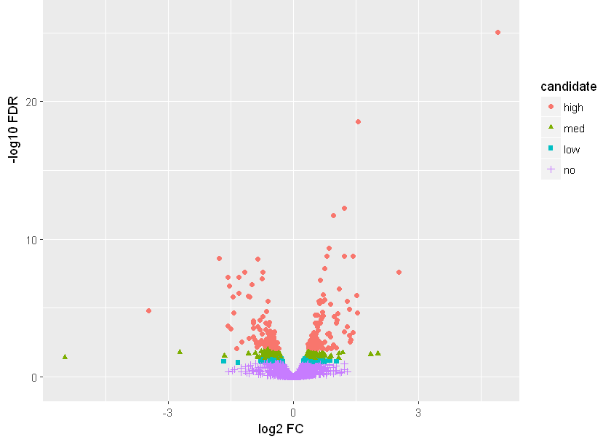
Proteomics workflow in PSR
1. Plan the
experiment
&
pick the samples
2. Sample disruption
3. Denaturing/solubilizing
Cell culture
4. Digestion
7. LC-MS/MS
5. Enrichment
(optional)
6. Mass tagging
(optional)
8. Data Analysis
Notes:
This slide deck gives an overview of some of the work that we do in the PSR for non-affinity immunopurification experiments. Whether a targeted or shotgun assay, the sample prep portion follows a similar workflow. This slide shows a brief overview of each step and subsequent slides will go into more detail.
The first step is to plan the experiment and design the study, preferably in collaboration with the PSR. Step 1 also involves picking samples for analysis. Step 2 involves physically disrupting the sample, to lyse cells or increase the surface area of tissues, so that Step 3, denaturation and solubilization, and occur more efficiently. The denaturation step disrupts secondary structures of proteins allowing them to unfold, which makes them more accessible to the digestion enzymes used in Step 4. The digestion enzymes, typically trypsin but others as well, cut the proteins into smaller pieces called peptides. In some experiments, enrichments are performed to look at certain post-translational modifications (PTM, Step 5). If quantitative results are desired, the peptides can be mass tagged in a multi-plex experiment (Step 6). Regardless of PTM enrichments or mass tagging, the final step in the sample prep is to inject and detect the peptides by LC-MS/MS (Step 7) then analyze the data (Step 8).

Slide 2
Step 1: Study design and sample collection
An often overlooked, but vital part of the experiment!
After goals of the experiment are discussed, need to plan for:
Scale (how much protein will be required)
How the samples will be collected
How many samples to include in each group
How the samples will be processed
How the samples will be analyzed via LC-MS/MS
The appropriate software to analyze the data
Please consult with the PSR staff before beginning your experiment
Notes:
The first step is to establish the study objectives and design the experiment, preferably in collaboration with the PSR. We will be able to help design the experiment knowing the strengths and limitations of our tools and techniques. Sample preparation methods vary with the type of samples analyzed.

Slide 3
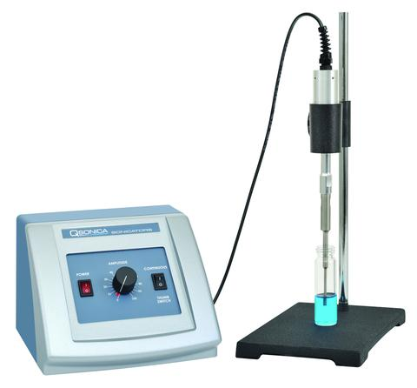
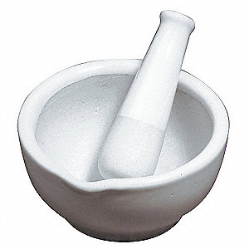
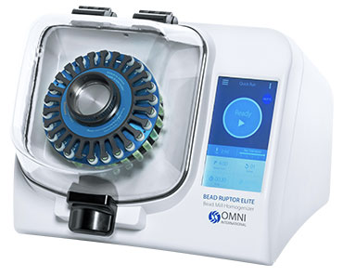
Step 2: Sample disruption Common techniques
Sonication
Bead beating
Cryogrinding
Good for cell lysates and soft tissues (lens)
Good for tougher tissues (brain, liver)
Freeze hard tissues with liquid N2 (bone, muscle)
Release contents/increase surface area, proteins are intact
Notes:
The next step is to disrupt the sample, the method used depending on the sample type. This will release the contents of cells and increase the surface area of tissues, but the proteins will remain intact.

Slide 4
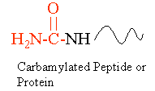
Step 3: Solubilization and denaturation Large-scale (>10 mg) sample prep lysis buffers
Unfolding and disruption of secondary structures
Urea
Breaks down to ammonia and isocyanate when heated above 55°C, resulting in carbamylated peptides
Interferes with acetyl immunopurification
Deoxycholate
Peptide recovery lower than when using urea or SDS
SDS
Interferes with digestion and MS analysis – must be removed
Notes:
The third step is solubilizing and denaturing the proteins. If we are working with >10 mg of proteins, this is typically done with lysis buffers such as urea, deoxycholate or SDS, each with its down advantages and disadvantages.

Slide 5
Step 3: Solubilization and denaturation Small-scale (<1 mg) sample prep techniques
ProteaseMAX (Promega)
Surfactant that enhances digestions (mass spec friendly)
Can be used for solution or gel samples
Enhanced filter-aided sample preparation (eFASP)
Uses cellulose 30 kDa MWCO filter to remove salts while retaining protein
Good for cytosolic and membrane protein with minimal sample loss
Good only up to 100 ug
Labor/time intensive
Notes:
If we are working with smaller amounts of protein, for example < 1 mg, then we might use ProteaseMAX or do an eFASP digestion, again, each with its advantages and disadvantages.

Slide 6
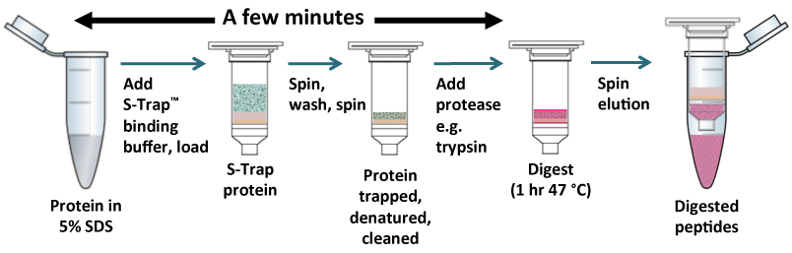
Step 3: Solubilization and denaturation Scalable sample prep technique
S-trap (ProtiFi)
Available in 3 sizes (<50 ug to >5 mg)
Proteins are lysed and solubilized with SDS, reduced/alkylated, then further denatured with acid
Proteins captured in pores of S-trap
Proteins digested in the S-trap, peptides spin eluted
www.protifi.com
Notes:
More recently we have started using S-traps to do some of our digestions. They come in 3 sizes so different amounts of protein can be accommodated. All of the steps occur in one vial/tube to minimize sample loss, and the procedure is much faster than eFASP.

Slide 7


Step 4: Digestion Common enzymes
Trypsin
Cleaves at carboxyl side of lysine (K) and arginine (R)
Optimal <2 M urea and pH 7-9
Lys-C
Often used in combination with trypsin
Cleaves at carboxyl side of K
Works in 8M urea
Glu-C
Cleaves at carboxyl side of aspartic (D) or glutamic acid (E)
Optimal pH 4-9
Trypsin: XXXGEK AIPSVEASLIFFALVK EXXX
XXXGEKAIPSVEASLIFFALVKEXXX
Glu-C: XXXGE KAIPSVE ASLIFFALVKE XXX
Notes:
The next step is digestion, where an enzyme (typically trypsin, but we use others when the situation warrants) cuts the protein into smaller pieces.
In the example at the bottom of the slide, using trypsin it would be difficult to localize on which serine the phosphorylation occurs. But if Glu-C was used, the serines would be in different peptides and it would be easy to differentiate them.

Slide 8
Step 5: Post-translational Modification Enrichment (Optional)

Slide 9
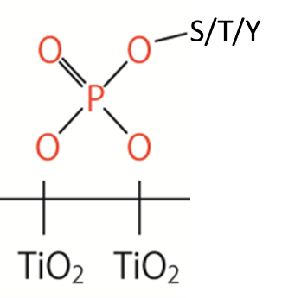
Phosphopeptide enrichment with TiO₂ beads
Background
Procedure
~1% of peptides are phosphorylated, 84:13:3 pS:pT:pY¹
TiO₂ beads (targets pS, pT, pY)
Mass shift +80
Peptides are dissolved in lactic acid/ACN solution
Phosphopeptides bind to TiO₂ beads
Acidic washes with decreasing %ACN to remove non-specific binding
Phosphopeptide elution with K₂HPO₄ pH 10
1. Batth, T.S. et al, Cell Reports, 2018, 22 (10), 2784-2796.
Notes:
We often perform phosphopeptide enrichments using TiO2 beads. The beads target phospho-modified serines, threonines and tyrosines. Adding a phospho group causes a mass shift of 80 Da. A more detailed description of the TiO2 enrichment method used can be found here.

Slide 10
Phospho Site Localization
Notes:
While discussing phosphopeptide enrichment techniques, it is worth taking a moment to discuss phospho site localization.

Slide 11
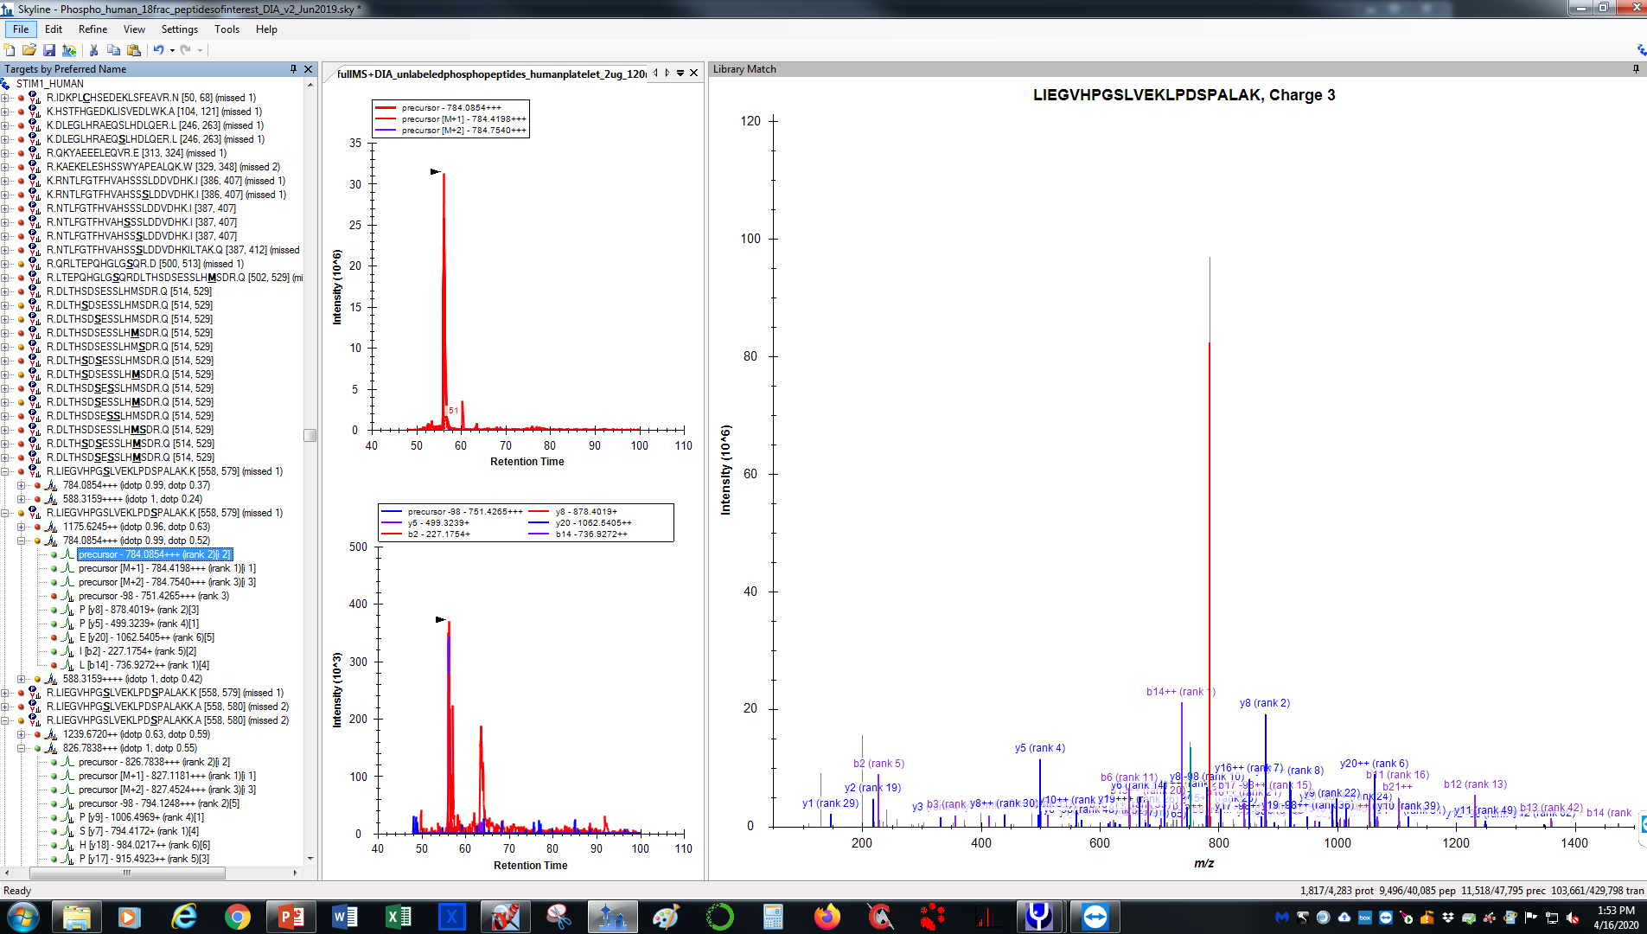
Sometimes there is evidence for site-specific phosphorylation
LIEGVHPGSLVEKLPDSPALAK
Evidence of both serines
being phosphorylated
y8
LIEGVHPGSLVEKL PDSPALAK
LIEGVHPGSLVEKL PDSPALAK
b14
Notes:
In the peptide shown in the slide, there are two possible phosphorylation sites (serines, shown in red). If the peptide has a mass shift of 80 Da, one of the serines is phosphorylated. In this case, there is MS2 fragmentation between the serines, and evidence of both serines being phosphorylated with the detection of the b14 and y8 ions. The underlined serines indicates it is phosphorylated.

Slide 12
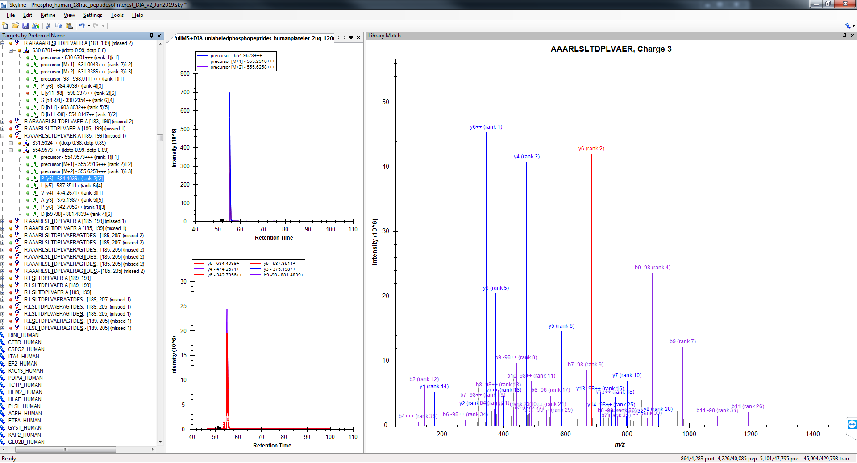
Sometimes there is NO evidence for site-specific phosphorylation
AAARLSLTDPLVAER
Impossible to localize
-Need evidence of b6/b7 or
y8/y9 to localize
Notes:
In this case, the two phospho sites are only separated by one amino acid, and there are no fragments that lead to any conclusive site localization. Therefore it is impossible to assign the phosphorylation event to either the serine or threonine.

Slide 13
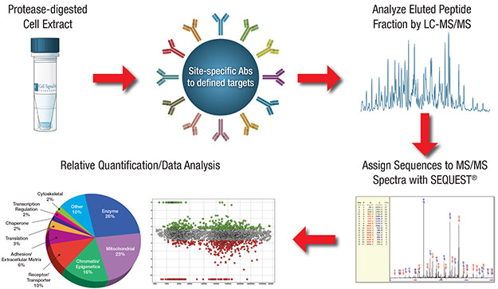
PTM enrichment with immunoaffinity purification
Cell Signaling Technologies has antibodies against several motifs:
Examples include:
Acetyl-lysine
Phosphotyrosine
Ubiquitin
Many others
www.cellsignal.com
Notes:
Some PTMs are enriched with immunoaffinity purification. Cell Signaling Technologies offers a suite of antibodies against many common PTMs.

Slide 14
Step 6: Quantitation with TMT Labeling Step 7: LC-MS/MS analysis
Step 8: Data Analysis
Notes:
Please refer to the more detailed slide set on TMT labeling for quantitative experiments: https://github.com/OHSU-Proteomics/TMT_overview_2020
Please refer to the more detailed slide set on LC-MS/MS analysis: https://github.com/OHSU-Proteomics/LC-MSMS
Please refer to the more detailed slide set on Data Analysis: https://ohsu-proteomics.github.io/Data_Analysis_Overview/

